Slide 1
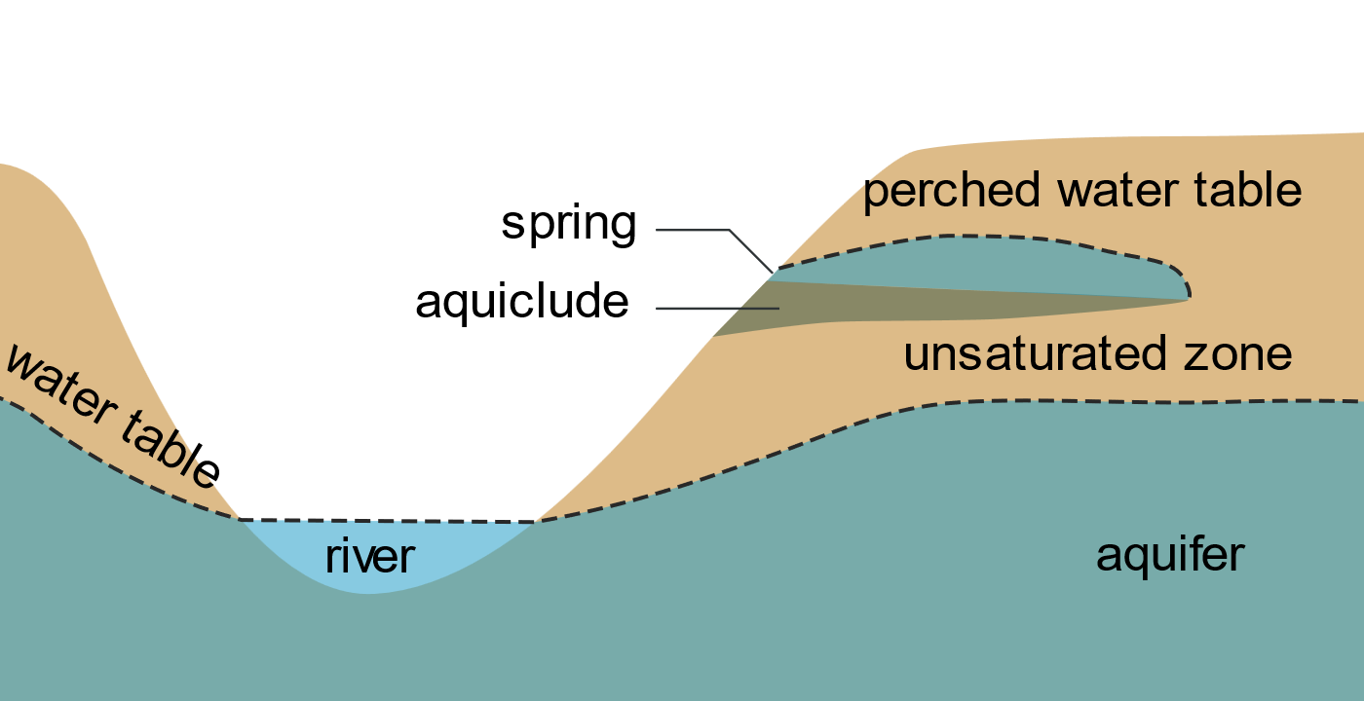
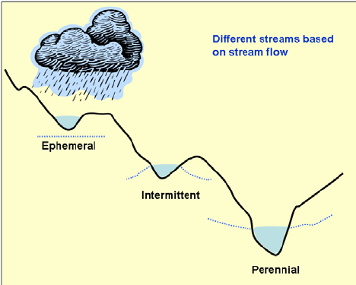
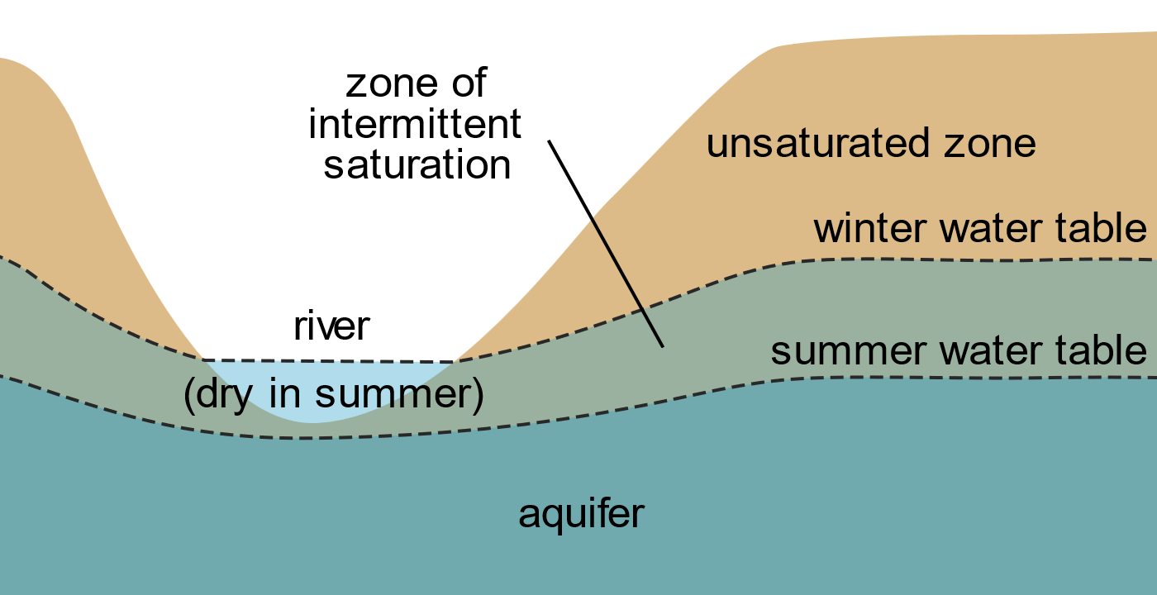
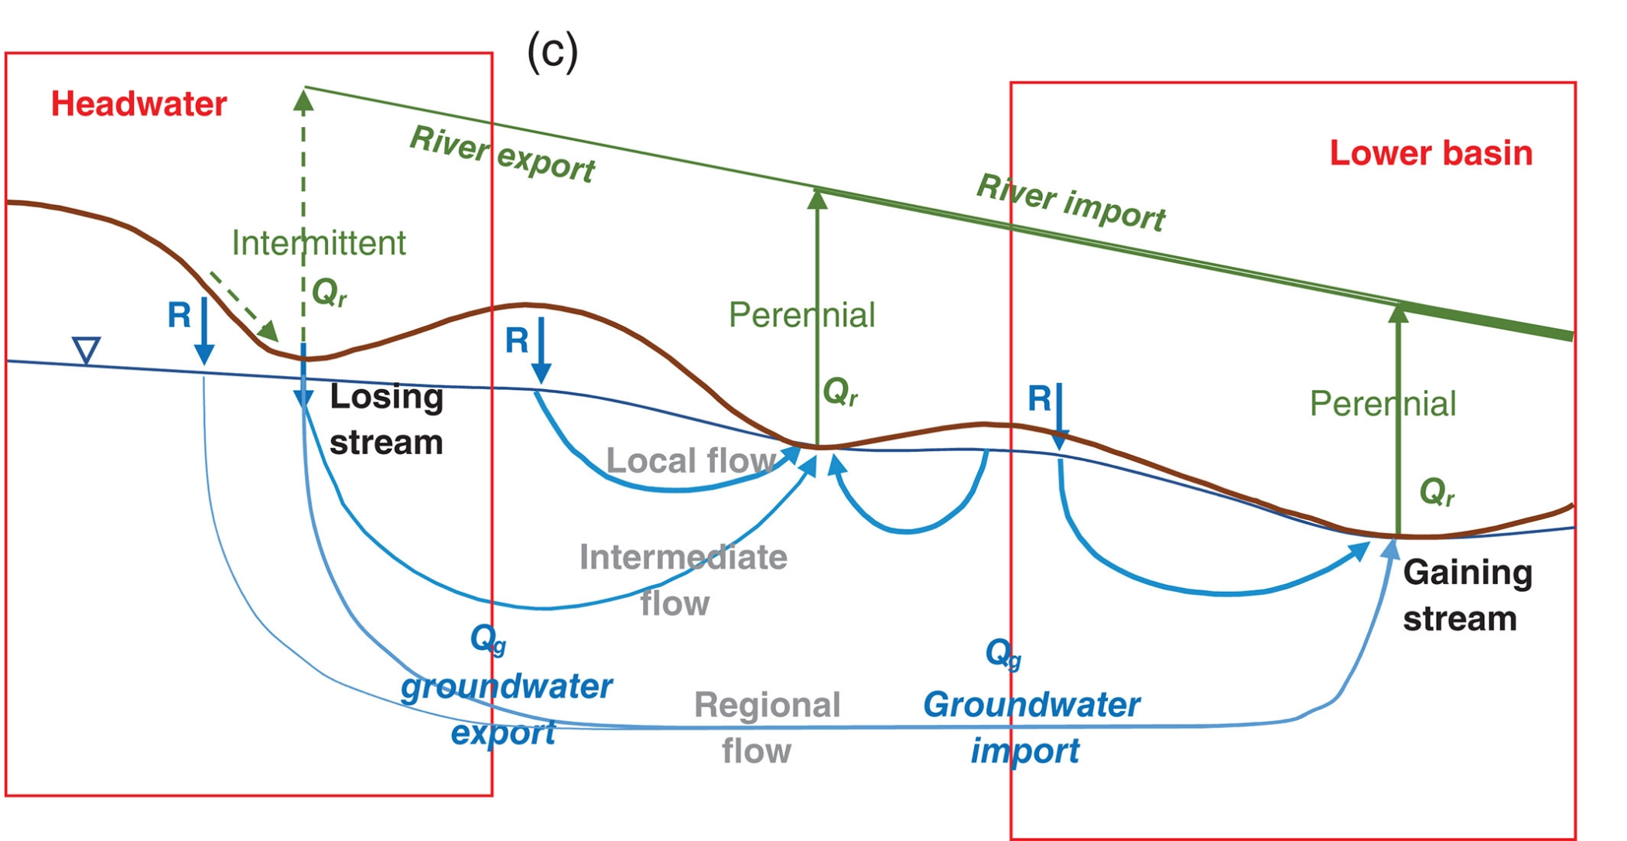
Navigable Water Protection Rule 2020:
“[Regulated] surface water channels must flow more often than just after a single precipitation event—that is, tributaries must be perennial or intermittent”
Perennial river
We’re trying to distinguish between these
Intermittent river
river
Ephemeral river
Fan 2019

Slide 2
Problems with gage-based modeling
Bias in gage locations, particularly w.r.t. to non-perennial streams
Krabbenhoft et al 2022
VERY few gauges are truly ephemeral (i.e. no baseflow) meaning data-driven modeling is nearly impossible
I did a hydrograph separation on ~7,000 streamgauges and 53 had 0 baseflow
Could serve as verification data, but not enough to train an ML model

Slide 3
Alternative approach to data-driven modeling: a geomorphic approach
Use modeled water table depths and catchment water balance
Fan et al 2017; 2013 global water table depth map!
Full soil water balance at 1km resolution forced by atmospheric/ecohydrological observations
Yields mean monthly water table depths
Calibrated/validated in North America using 1,000,000+ well depth measurements

Slide 4
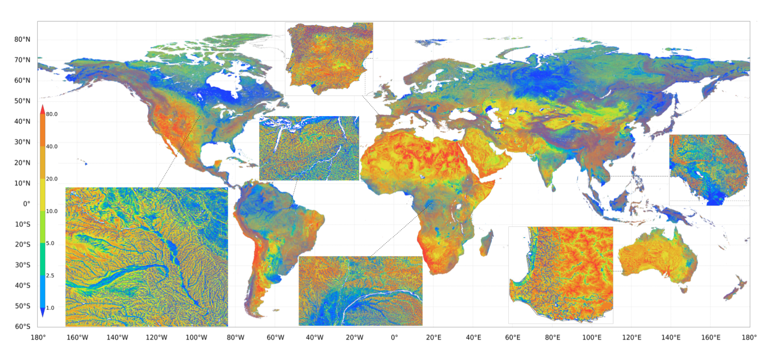
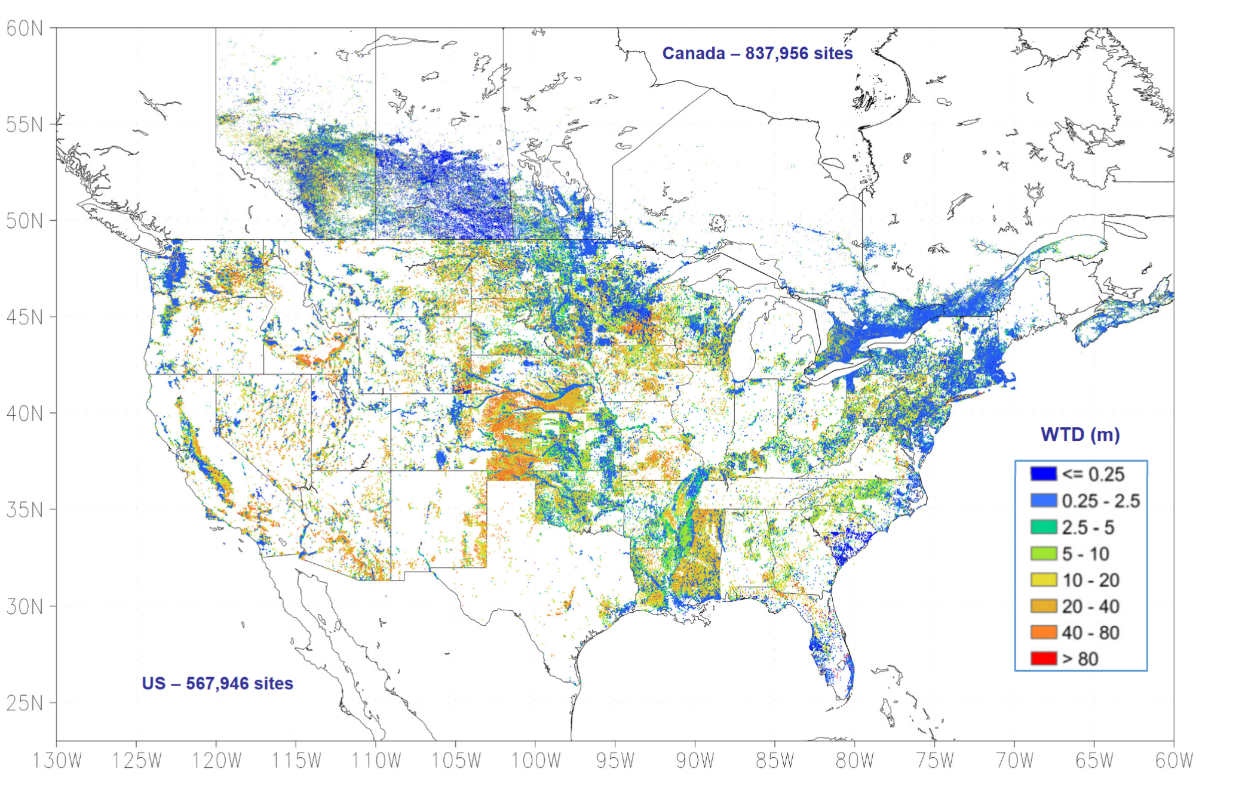
Water table depths

Slide 5
Is water table below the river/lake/reservoir?
(after accounting for waterbody depth)
Threshold for ‘persistent surface saturation’ (Fan 2013): -0.25m
Yes
Is this true all 12 months?
No
Yes
No
Is upstream river also non-perennial?
Yes
No
Is it a losing stream?
i.e. dQ/dx < 0?
Yes
No
Ephemeral stream
Non-ephemeral stream
Perennial river
Potentially unregulated
Still regulated

Slide 6
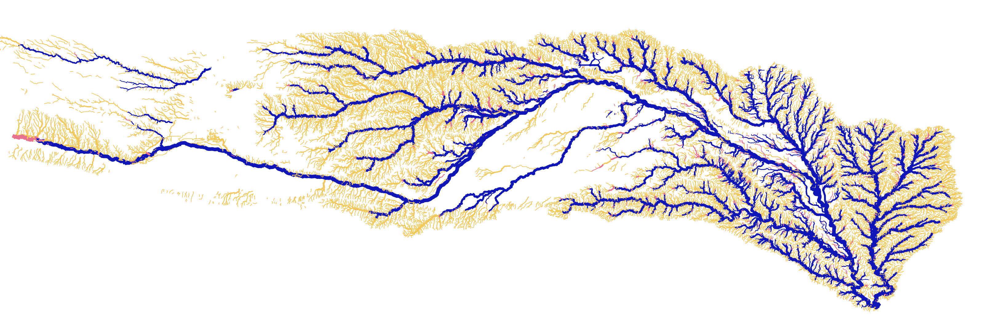
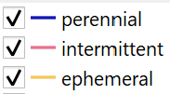
HUC4 river map low example
Arkansas River
HUC 1104 | % Q | % surface area
Ephemeral | 3% | 93%
Intermittent | 2% | 6.9%
Perennial | 95% | 0.1%
(size by stream order)

